Slide 1
CMP 2203
Digital Logic

Slide 2
Who Am I
Name: Dativa K. Tizikara - BSc. (EE) , MSc. (EE)
Contacts:
Mobile: +256 776 120802 , Mon – Fri, ( 8 am to 5 pm) ONLY
Email: dtizikara@gmail.com
Office: Room 3001, CEDAT New Building.
Walk-in student hours: Friday (2 – 4 pm ). Any other time is by appointment ONLY

Slide 3
About the Course
Course work (40%)
Exam ( 60 %)
Participate actively in class.
Ask questions
Discuss
Prepare for the lecture in advance
Late submission of course work/ missing tests is not tolerated
A lot of material. Study hard!

Slide 4
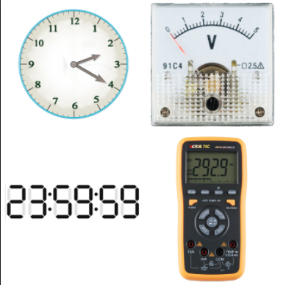
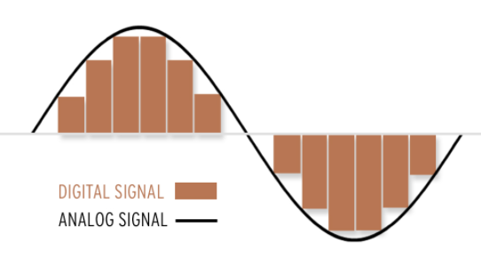
Analog Vs Digital
Image source: google

Slide 5
Analog Vs. Digital representations
Analog
Quantities represented by continuously variable, proportional indicators e.g. speedometer with needle, mercury thermometers, microphone etc.
Vary over a continuous range of values e.g. 0 – 180 for speedometer etc.
Values open to interpretation e.g. if dial in between two digits
Digital
Represented by discrete values (i.e. step by step) e.g. digital clock changes in steps of minutes and second

Slide 6
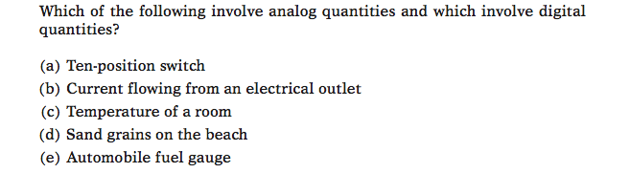
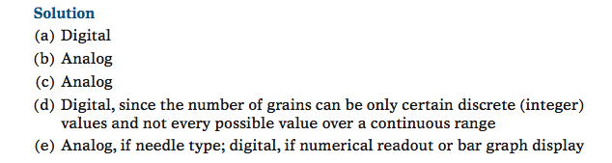
Analog Vs. Digital
Question

Slide 7
Digital Computers
How digital computers work: manipulate on/off signals to implement logic functions.
How are these on/off signals generated: mechanical devices > electromagnetic relays > vacuum tubes > transistors > ICs etc.
How do digital computers think: 1’s and 0’s and on logical rules defined by George Boole
Home work:
Advantages and Limitations of digital Techniques

Slide 8
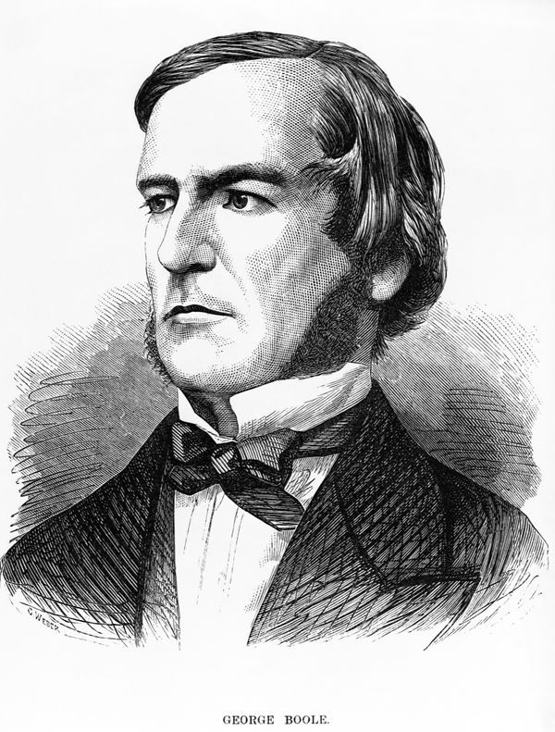
George Boole (1815 -1864)
English mathematician
Came up with Boolean Logic in his work “The Mathematical Analysis of Logic” in 1847 and expanded on it in 1854
3 operations (AND, OR, NOT) , can perform all logic functions
Work seemingly useless until applied by Claude Shannon while designing telephone switches
Boolean Algebra foundation of digital logic today
Image source: www.computerhistory.org

Slide 9
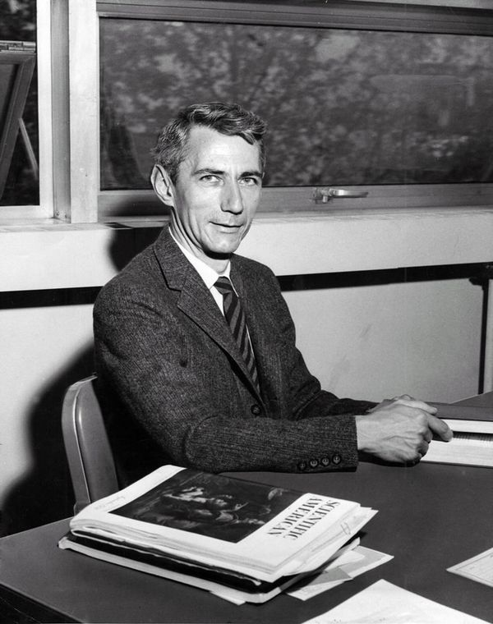
Claude Shannon (1916 -2001)
Applied Boolean Algebra to design of logic circuits using electromechanical relays
Laid foundation for switching theory used in computers today
Later also showed how information could be quantified and encoded in a universal language of binary digits (bits)
Image source: www.computerhistory.org

Slide 10
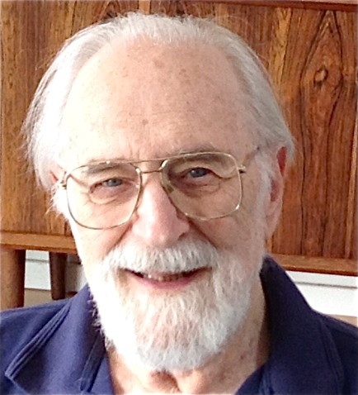
Maurice Karnaugh (1924 - )
American Physicist known for Karnaugh map (K- map)
Method that simplifies Boolean algebraic expressions
Image source: wikipedia.org

Slide 11
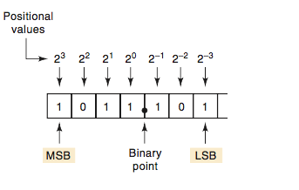
Digital Number Systems
Decimal system: 10 digits so hard to implement in digital system
Binary system
Easy to design simple, accurate systems that can work with 2 digits
For N bits, there are 2^{N} counts and largest number (in decimal) of all 1’s is 2^{N}-1
Question: Convert 1011.101₂ to base 10

Slide 12
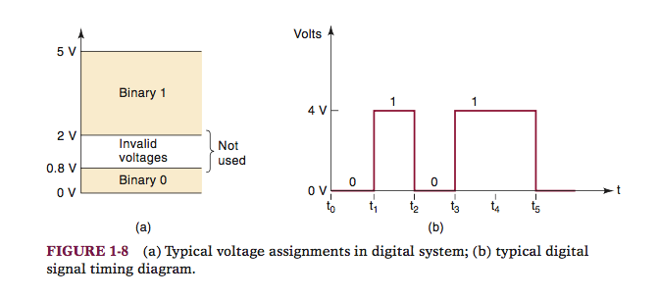
Representing Binary Quantities
Can be represented by any device that has only 2 operating states: ON/OFF, TRUE/FALSE, 0/1, HIGH/LOW e.g. a switch (open/closed), light bulb, diode, transistor, photo cells etc.
In electronic systems, represented by voltages or currents, usually 0V and +5V.
Due to actual circuit variations, actually voltages ranges represent 0 and 1
Digital signal variation over time represented by a timing diagram
Transitions in actual fact are not instantaneous
Timing diagram
Image source: Tocci

Slide 13
Digital/Logic Circuits
Designed to produce output voltages that fall within 0 to 1 range and to respond predictably to inputs in same range
Manner in which digital circuits respond to an input is called the circuit’s logic
Most digital circuits are IC’s produced from different technologies: CMOS, TTL, NMOS and ECL being most common.
Differentiated by principal element e.g. TTL (transistor-transistor logic uses BJT) and CMOS( common metal oxide semiconductor uses MOSFET)

Slide 14
Logic Design
Basic circuit organization of a digital computer
Elementary building blocks of digital circuits are called gates
Gates are made from switches (mechanical or electrical): receive an input signal, process it and transform it into an output signal
Operate based on Boolean algebra to determine the value of an output signal ( 1 or 0), or to save a value in a flip-flop > a storage unit made of a combination of gates that can perform basic arithmetic
Basic gates are AND, OR, NOT. Others are NAND, NOT, NOR, XNOR
Most have 1 or 2 inputs and one output

Slide 15
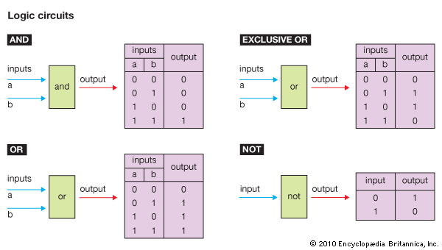
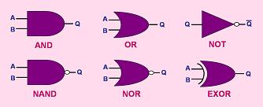
Logic Gates
Image source: Britannica.com
More on this Later !

Slide 16
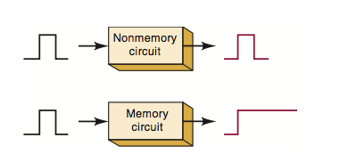
Memory
Most circuits: respond to an applied input, when input is removed, output returns to original state i.e. have no memory
Some digital circuits: remain in output state even after input is removed

Slide 17
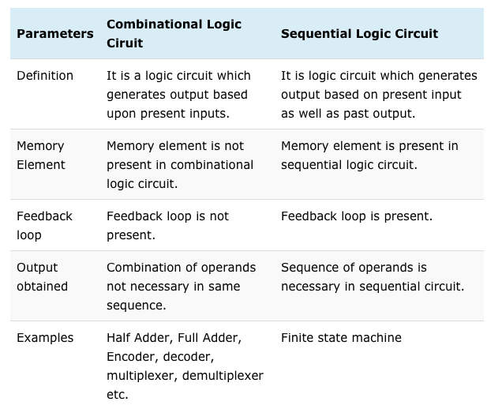
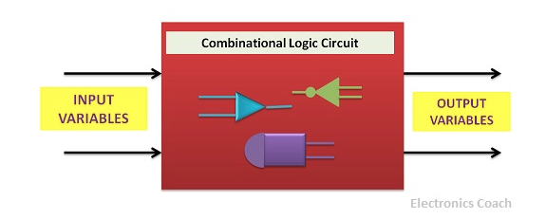
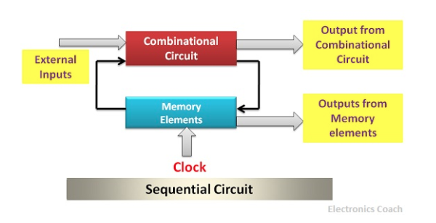
Combinational and Sequential circuits
Made from combination of logic gates
Source:https://electronicscoach.com

Slide 18
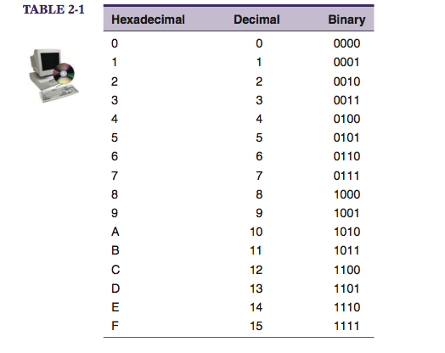
Number Systems and Codes
Convert:
9F2₁₆ to binary
1110100110₂ to HEX
* Learn 4 bit pattern for 0-F!
_{Why do we need HEX?}
Shorthand to represent long strings of bits: convenient, less errors
Source: Tocci

Slide 19
References
http://www.computerhistory.org/revolution/digital-logic/
https://www.britannica.com
Ronald J. Tocci, Neal S. Widmer, Digital Systems Principles and Applications, Prentice Hall Inc, 2007

